Slide 1

KPR Institute of Engineering and Technology
Internship Review
Dharshini C – 23EE008 II-EEE

Slide 2
About the Company
Litz Tech Private Limited is a dynamic and innovative technology company specializing in software development, web development, and IT solutions.
With a strong focus on delivering high-quality digital products, the company provides services in website design, mobile app development, UI/UX design, and enterprise solutions.
As an intern at Litz Tech Private Limited, I had the opportunity to gain hands-on experience in front-end development, working with technologies like HTML, CSS, Bootstrap, and JavaScript.
The company’s structured training, mentorship, and real-world projects provided a strong foundation for learning and growth.

Slide 3
Week – 1
The first week of the internship was started with the Introduction to front-end development and web technologies provided a foundational understanding of how websites are built and function.
The learning journey began with the basics of HTML, including working with tables, forms, and typography.
Hands-on tasks reinforced these concepts by creating a student information table and an employee salary table.
Moving forward, CSS (Cascading Style Sheets) was introduced to enhance the styling and design of web pages.
Practical applications of these skills included designing a resume using HTML and CSS, followed by a website design practice session where a basic animal-related website was created.

Slide 4
Week – 2
The second week focused on advancing front-end development skills with Bootstrap and JavaScript.
It began with an introduction to Bootstrap, covering its grid system, components, and responsiveness.
A hands-on task involved designing a fully functional login page using Bootstrap. JavaScript basics were introduced to add interactivity to web pages, followed by a project where an animal website was developed using Bootstrap.
The integration of JavaScript continued with implementing functions for interactivity and enhancing forms with validation.
Towards the end of the week, the focus shifted to the final front-end project, involving project initiation, implementation, testing, and final review.

Slide 5
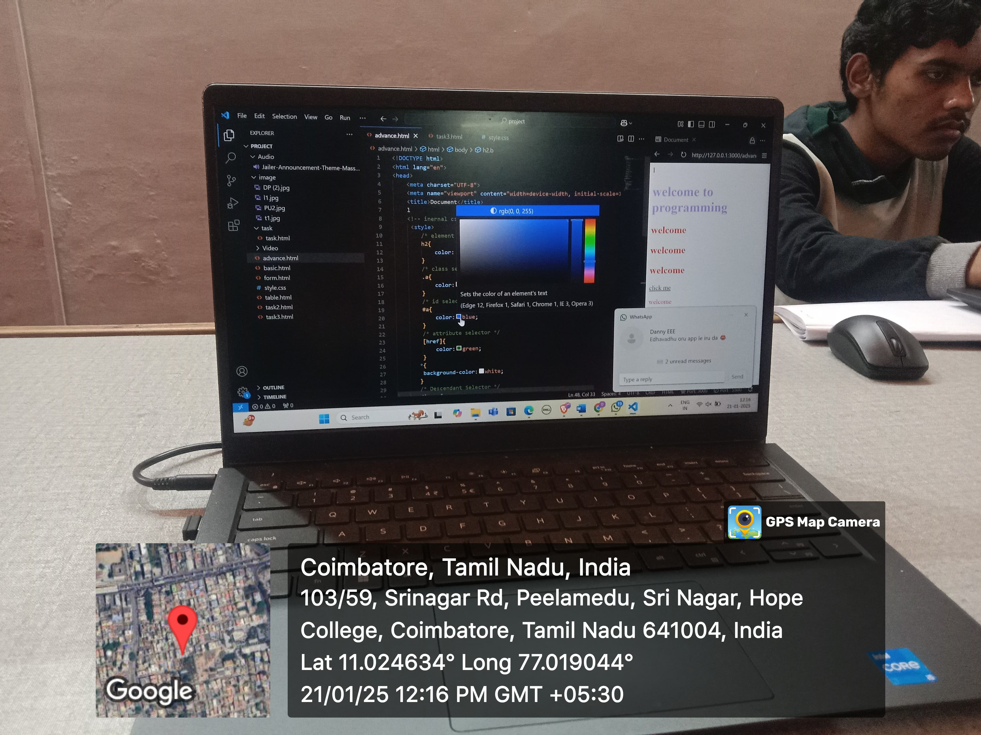
Daily Logs
Day 1:
On the first day of my internship, I was introduced to front-end development and the core languages used in building user interfaces.
The session covered the basics of HTML, the backbone of web structure. It highlighted its importance in creating, organizing, and designing web pages effectively.

Slide 6
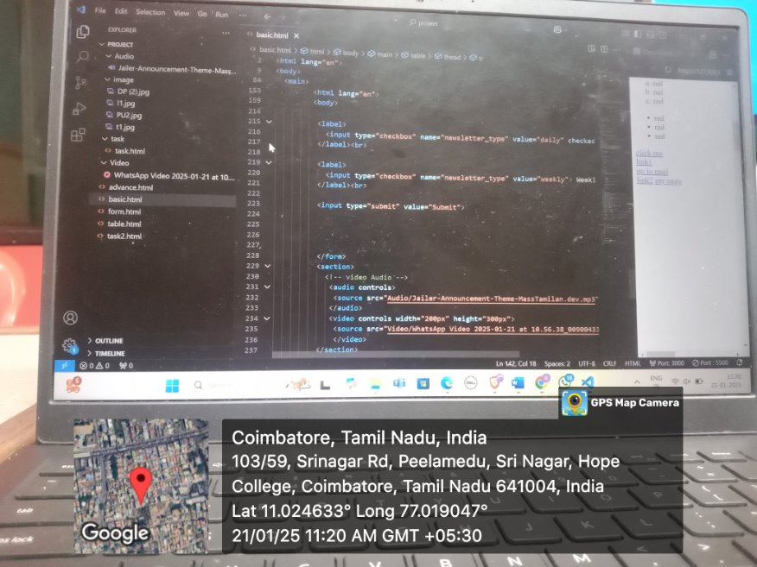
Daily Logs
Day 2:
On the second day of my internship, I worked on tasks involving tables, forms, and typography.
These exercises helped me understand how to structure data, create user-friendly input fields, and enhance text presentation.
Additionally, I learned valuable insights about web designing principles and improving user interface.

Slide 7
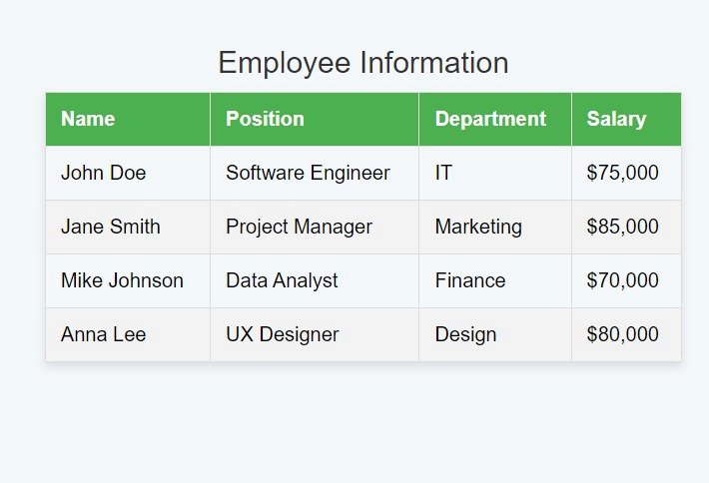
Daily Logs
Day 3:
On the third day of my internship, I created a student information table and an employee salary table to practice organizing and presenting data effectively.
Additionally, I replicated some of my college's forms by designing a Google Form, which enhanced my understanding of form structure and user interaction.

Slide 8
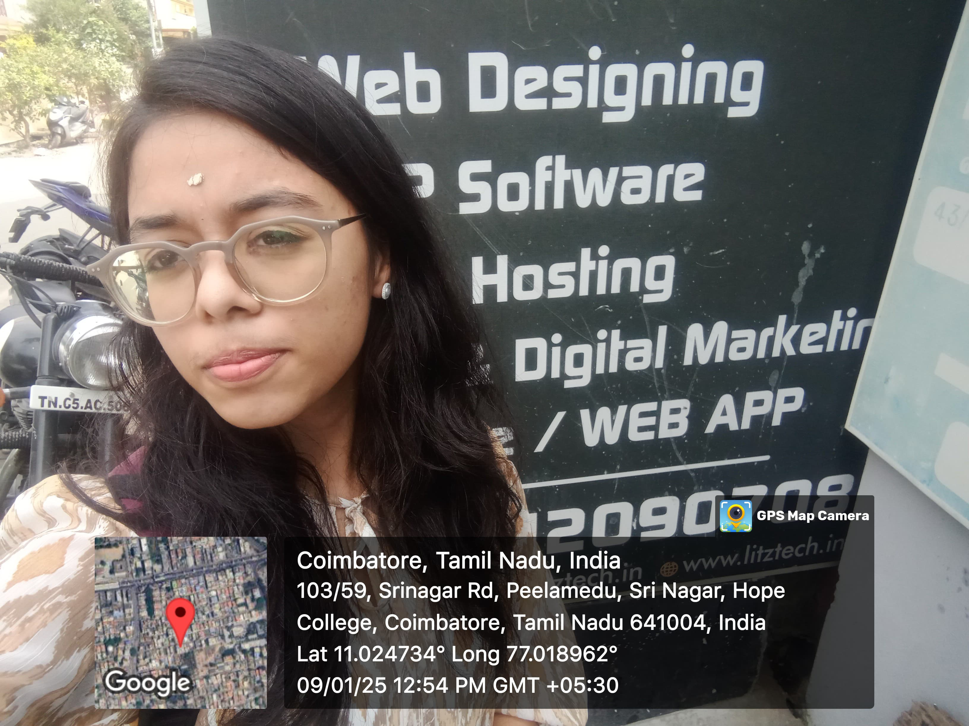
Daily Logs
Day 4:
On the fourth day of my internship, I learned how to create a resume using HTML.
I worked on a task to design my resume with various font styles, focusing on enhancing its appearance and making it visually appealing.
This activity improved my skills in styling and formatting content effectively.

Slide 9
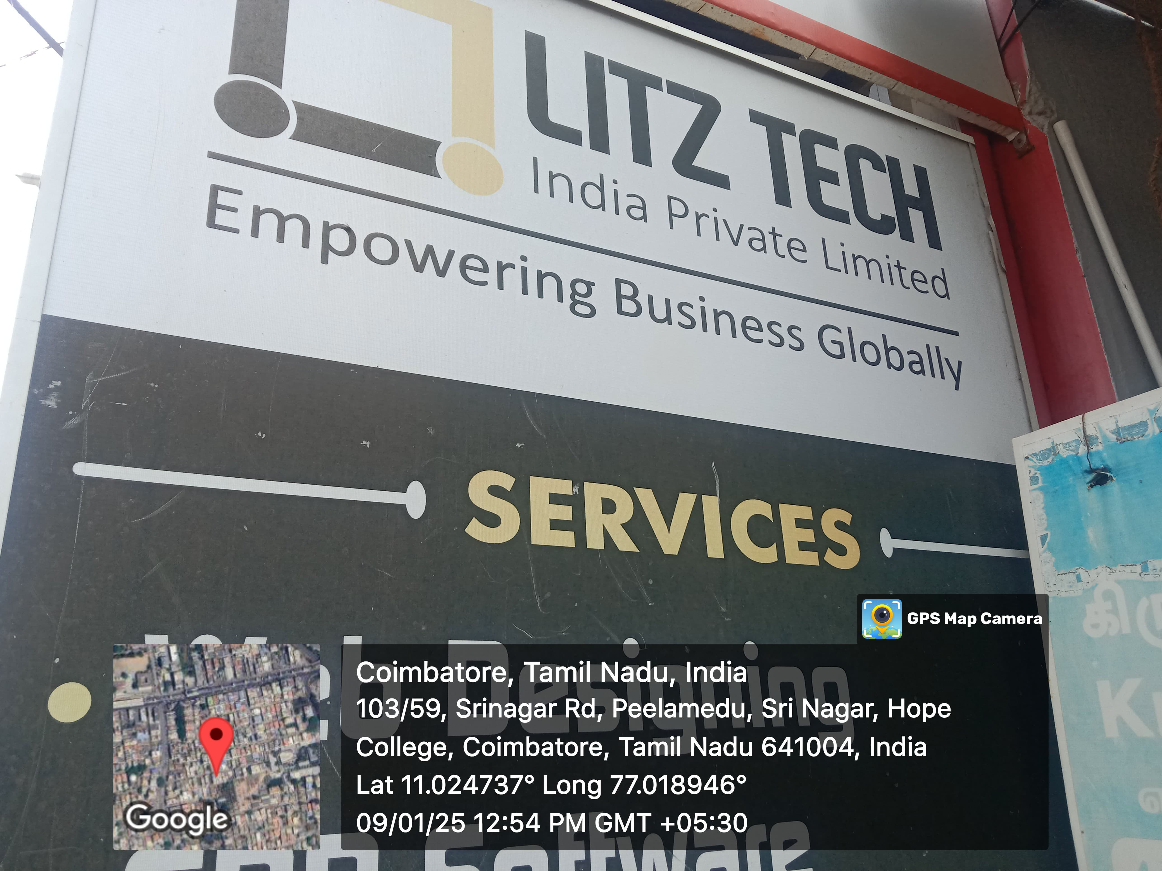
Daily Logs
Day 5:
On the 5th day of my internship, I was introduced to CSS (Cascading Style Sheets) and learned how to use it for website design.
I explored adding colors, aligning elements, incorporating images, and enhancing overall aesthetics.
This session helped me understand how CSS brings life and style to web pages.

Slide 10
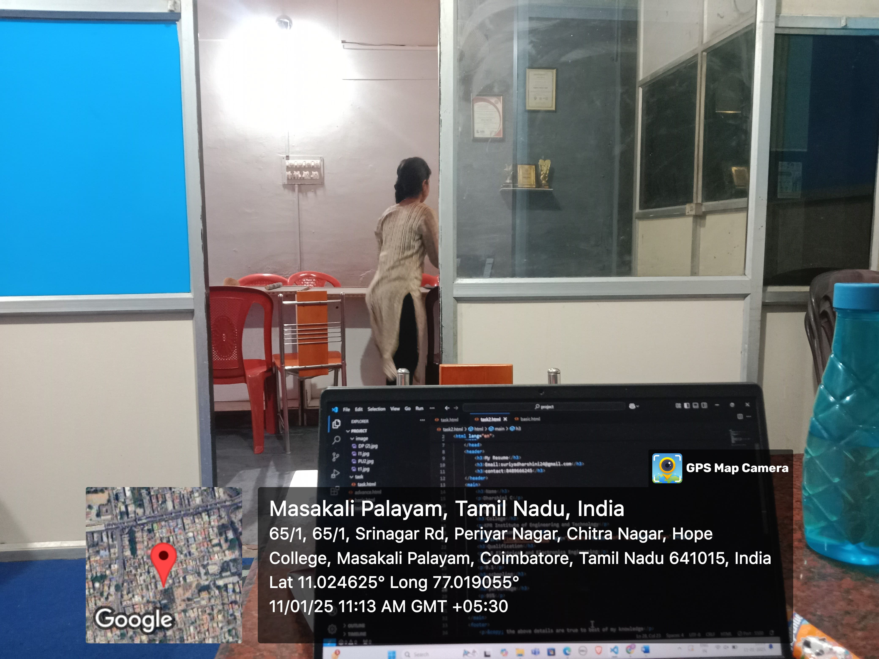
Daily Logs
Day 6:
On the sixth day of my internship, I designed a website related to animals, applying the knowledge I had gained so far.
I utilized HTML for structure, CSS for styling, and incorporated elements like images, colors, and typography to create an engaging and visually appealing website.

Slide 11
Daily Logs
Day 7:
On the seventh day of my internship, I learned about Bootstrap, a powerful CSS framework.
It provides an advanced version of CSS with pre-designed components and responsive design features, making website development faster and more efficient.
This session enhanced my understanding of modern web development practices.
Day 8:
On the eighth day of my internship, I created a fully functional login page using the knowledge I had gained so far.
I combined HTML, CSS, and Bootstrap to design an attractive and user-friendly interface, ensuring proper alignment, styling, and responsiveness.
This task reinforced my learning effectively.

Slide 12
Daily Logs
Day 9:
On the ninth day of my internship, I learned the basics of JavaScript and its application in websites.
I explored how to add interactivity, handle events, and enhance user experiences.
This session gave me a strong foundation for implementing dynamic functionality in web development.
Day 10:
On the tenth day of my internship, I designed a website for animals using Bootstrap.
I utilized its responsive grid system, components, and utilities to create an attractive and functional website.
This project helped me enhance my skills in building professional-looking, mobile-friendly web designs.

Slide 13
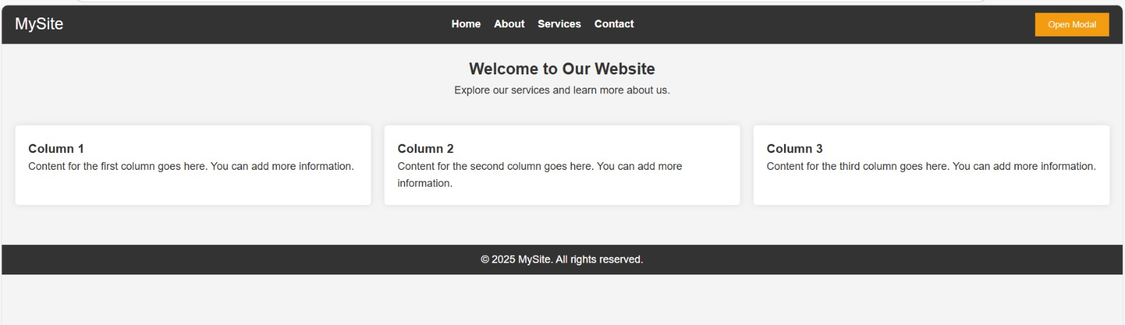
Daily Logs

Slide 14
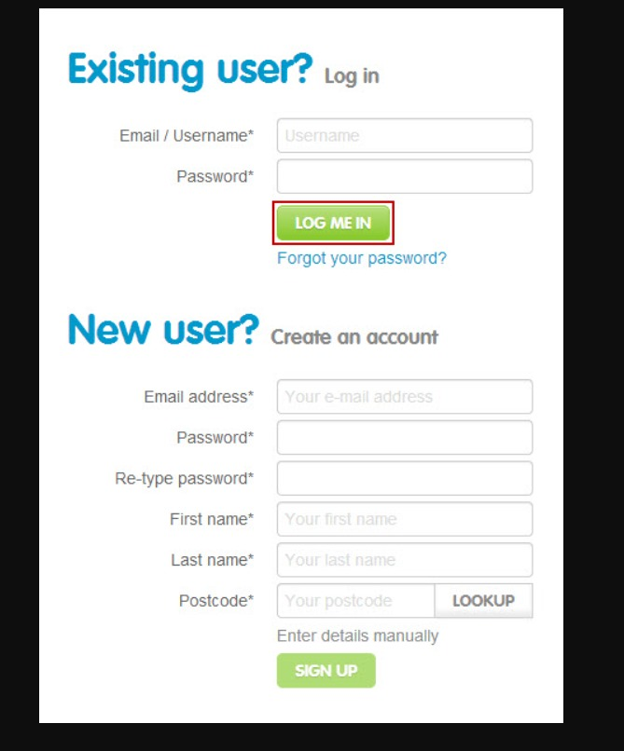
Daily Logs
Day 11:
On the eleventh day of my internship, I learned how to implement JavaScript in my projects to add functionality.
I explored how to create dynamic features, handle user interactions, and manipulate elements on the webpage, further enhancing my web development skills.

Slide 15
Daily Logs
Day 12:
On the twelfth day of my internship, I applied JavaScript to enhance the functionality of my website projects.
I focused on creating interactive features, validating forms, and improving user experience.
This hands-on practice strengthened my understanding of JavaScript and its role in dynamic web development.
Day 13:
On the thirteenth day of my internship, I was introduced to a new project focused entirely on front-end development.
This project aimed to apply all the concepts I had learned, including HTML, CSS, Bootstrap, and JavaScript, allowing me to showcase my skills in designing and developing user interfaces.

Slide 16
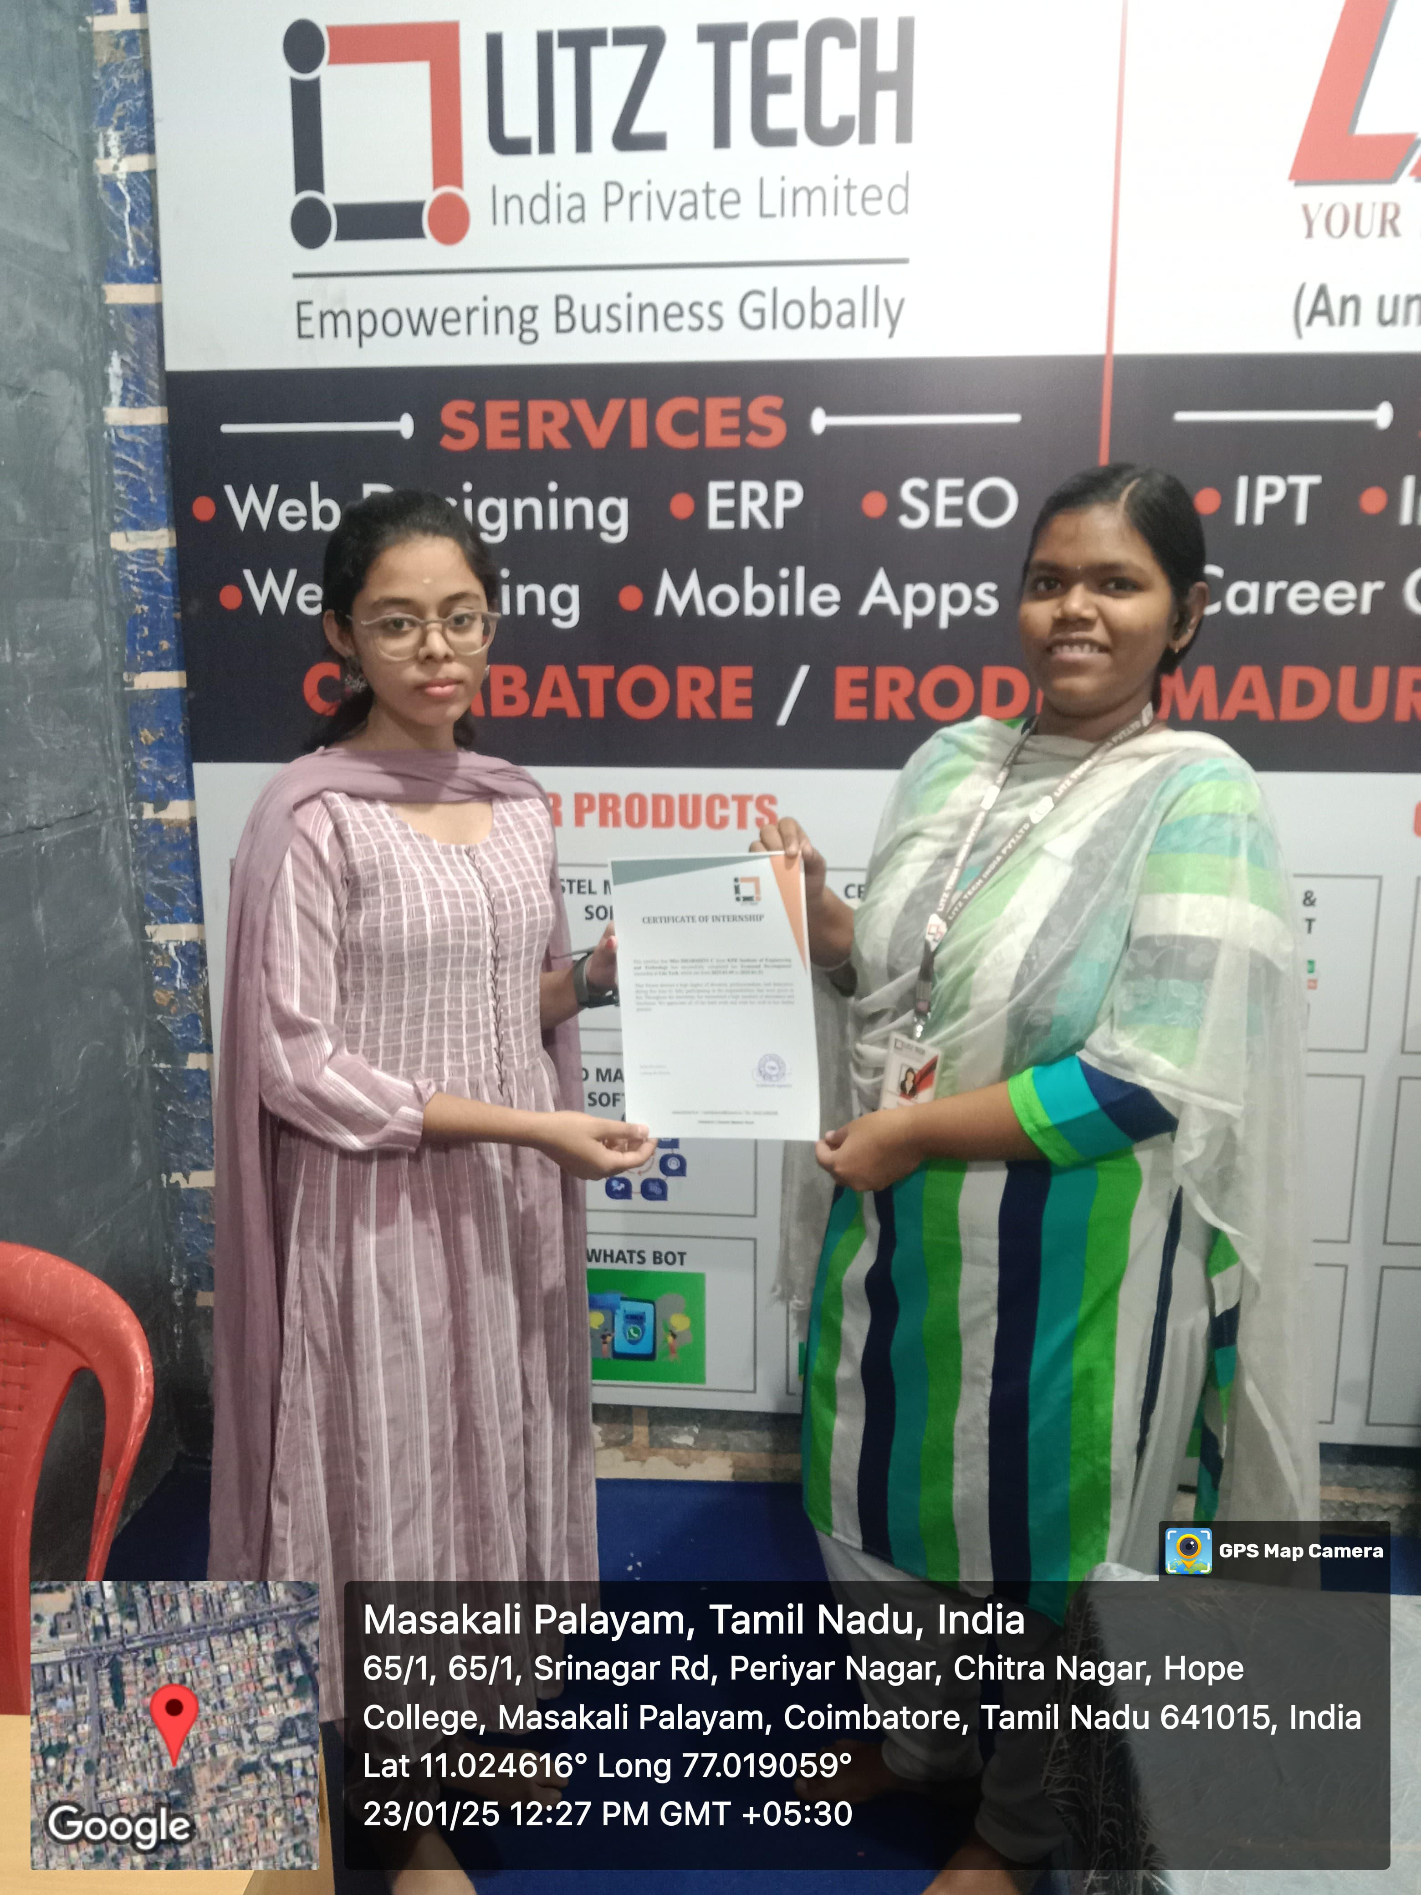
Daily Logs

Slide 17
Learned from Internship
During my internship at Litz Tech Private Limited, I gained valuable technical skills,
hands-on experience, and industry insights in front-end development. The following are
the key areas I learned:
Fundamentals of Front-End Development
HTML (HyperText Markup Language)
CSS (Cascading Style Sheets)
Bootstrap Framework
JavaScript Basics & Implementation
Website Development & Projects
Professional & Industry Exposure

Slide 18
Future Works
Implementing My Internship Skills in Future Work for:
Web Development & Personal Projects
Academic Projects & Research Work
Industry Readiness & Job Opportunities
Entrepreneurial & Freelancing Opportunities

Slide 19
THANK YOU

